Slide 1

CAPSTONE PROJECT
Hotel Booking Cancellation Prediction

Slide 2

Project Title :- Hotel Booking Cancellation Prediction
Group No. 4
Names of Group Members:
Ms. Eveline Jemima
Mr. Ankit Kumar
Mr. Harsh Priyadarshan
Ms. Sona Paul
Mr. Partho Sarothi Biswas
Under the Guidance Of
Mr. Pratik Sonar

Slide 3
Problem Statement
In the dynamic landscape of online bookings, high cancellation rates pose formidable challenges for revenue and hotel managers. Once a reservation is cancelled, rectification options are limited, necessitating a proactive approach. Predictive analysis emerges as a crucial tool, empowering managers to anticipate cancellations, refine overbooking strategies, and optimize cancellation policies. This strategic foresight enables more informed decision-making, mitigating the impact of cancellations on room inventory and improving overall operational efficiency. By embracing predictive analytics, the hospitality industry can fortify itself against the uncertainties associated with booking cancellations, ultimately fostering improved revenue management.

Slide 4
Business Objective
By predicting which bookings are likely to be canceled, hotels can allocate their resources more effectively. It enables hotels to adjust their pricing strategies based on the likelihood of cancellations. Hotels can offer discounted rates for rooms that are expected to be canceled, thereby attracting more bookings, and maximizing revenue. Overbooking can lead to customer dissatisfaction and operational challenges. Cancellation predictions help hotels avoid overbooking by adjusting room availability and reservations to match expected occupancy rates. During peak seasons or special events, cancellations can disrupt operations and revenue. Accurate predictions enable hotels to prepare for such scenarios and make necessary adjustments.

Slide 5
Current Solution To The Problem
Some of the currently used approaches for Hotel Booking Cancellation Prediction are :
• Logistic Regression
• Random Forest Classifier
• Decision Tree Classifier
• Bagging Classifier
• AdaBoost Classifier
• Gradient Boosting Classifier
• XGBoost Classifier

Slide 6
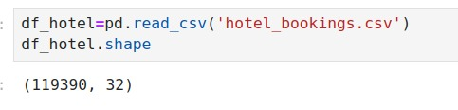
Dataset Information
• Number of rows:119390
• Number of columns:32
• Number of Categorical Columns:12
• Number of Numerical Columns:20
• Target Column name: is_canceled

Slide 7
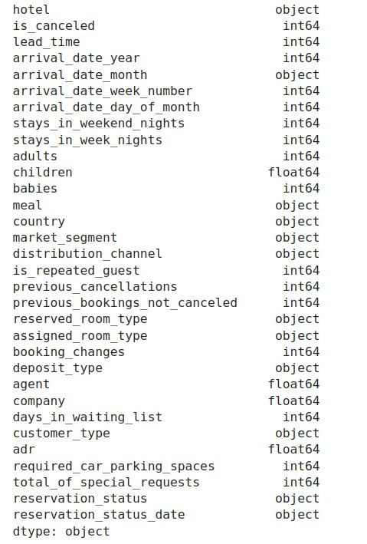
Columns Name
As we can see :
There are 12 categorical columns.
There are 20 numerical columns.

Slide 8
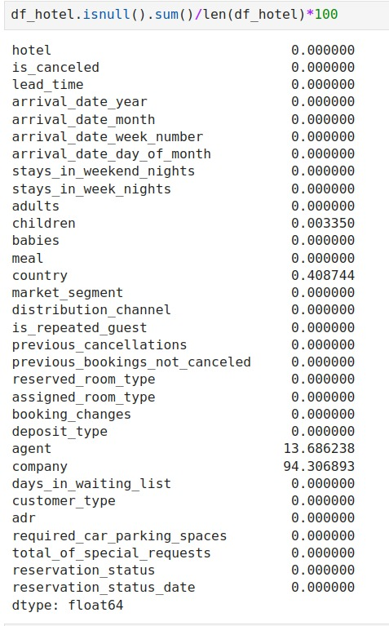

Null Value Percentage
As the column ‘company’ is having null value percentage as 94.3, we are dropping that column.

Slide 9
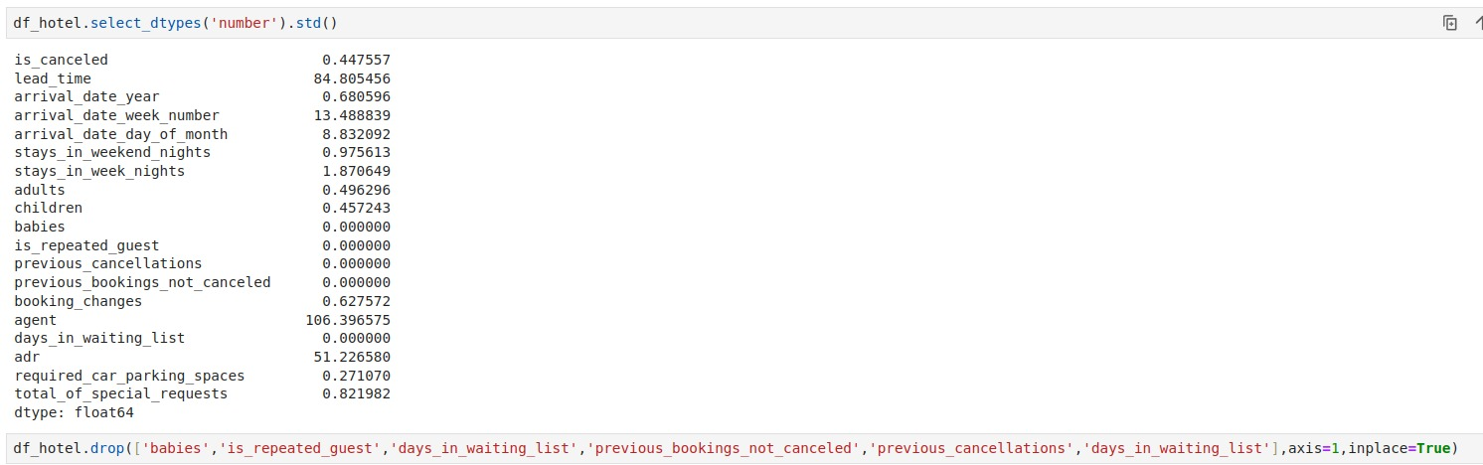
Exploratory Data Analysis(EDA)
As we are getting standard deviation value as 0 for some of the numerical columns, we are dropping it because it won’t add any information for predictive modeling as all the values in that column are identical, and there is no variability.

Slide 10
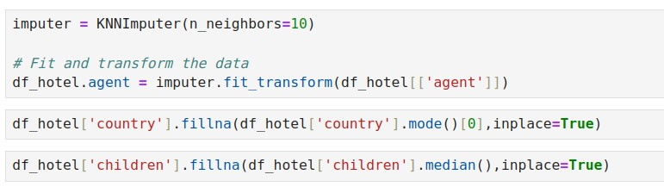
Exploratory Data Analysis(EDA)
We imputed the column 'agent' with KNNImputer with n_neighbors as 10. KNN imputation is generally robust to outliers because it relies on the similarity of instances rather than their absolute values. We imputed the categorical column 'country' with mode value and the numerical column 'children' with median value.
We dropped the duplicate records

Slide 11
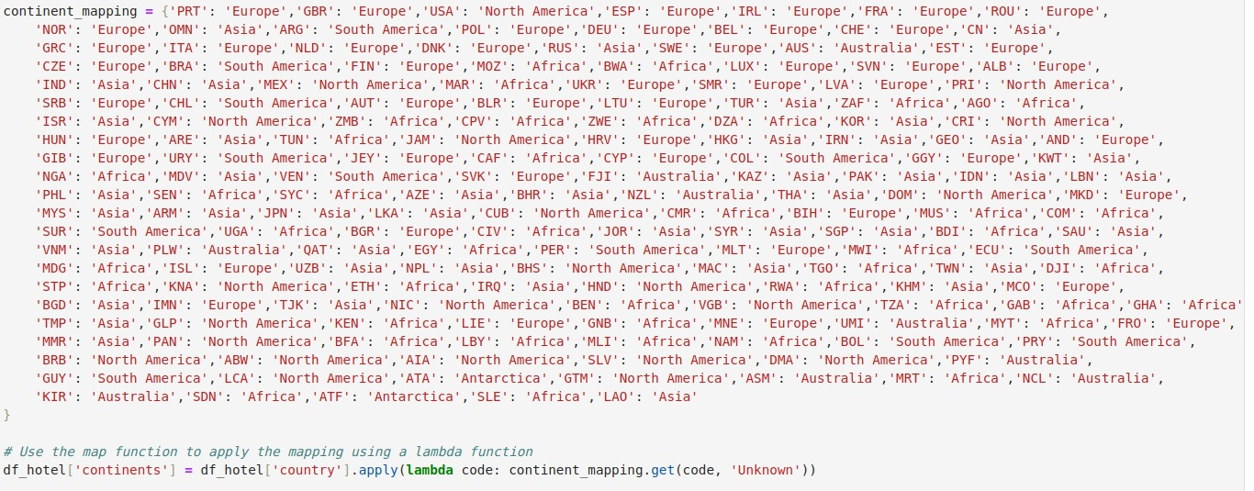
Exploratory Data Analysis(EDA)
We have converted all the countries to continents

Slide 12
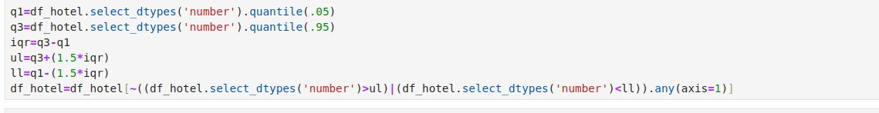
Exploratory Data Analysis(EDA)
Nearly half of the dataset is having outliers. So we can't remove it entirely.
So we set Q1 as 0.05 and Q3 as 0.95 and treated the outliers.

Slide 13
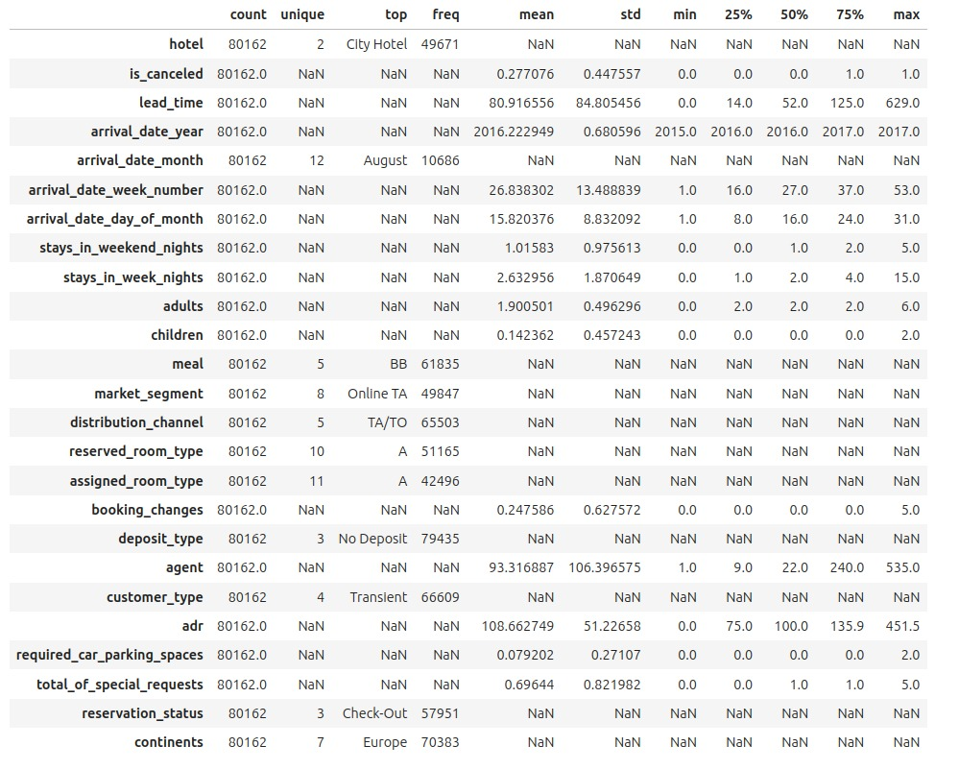
Exploratory Data Analysis(EDA)
5 POINT SUMMARY:

Slide 14
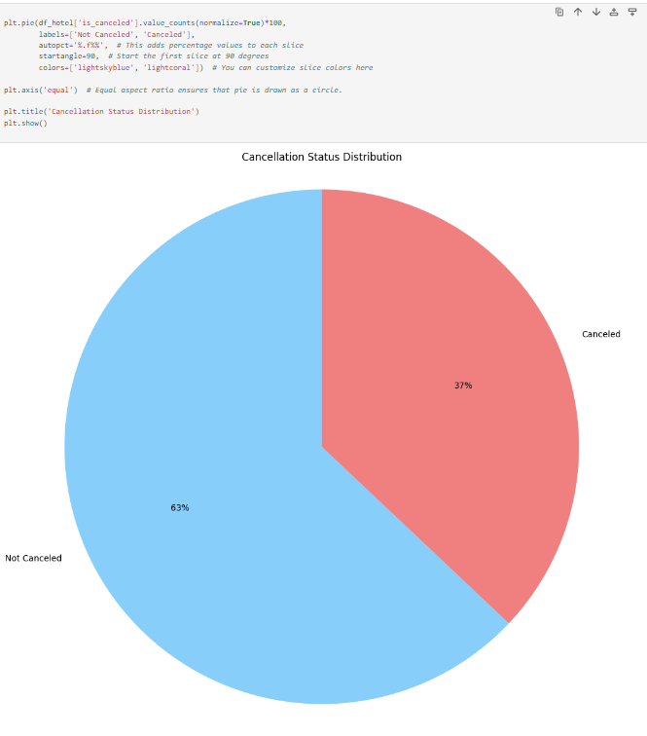
The pie chart illustrates the distribution of hotel booking cancellations, with 'Not Canceled' and 'Canceled' categories. Approximately 63% of bookings were not canceled, while 37% were canceled.
This visual representation provides a clear overview of the cancellation status distribution in the dataset, aiding in understanding booking outcomes.

Slide 15
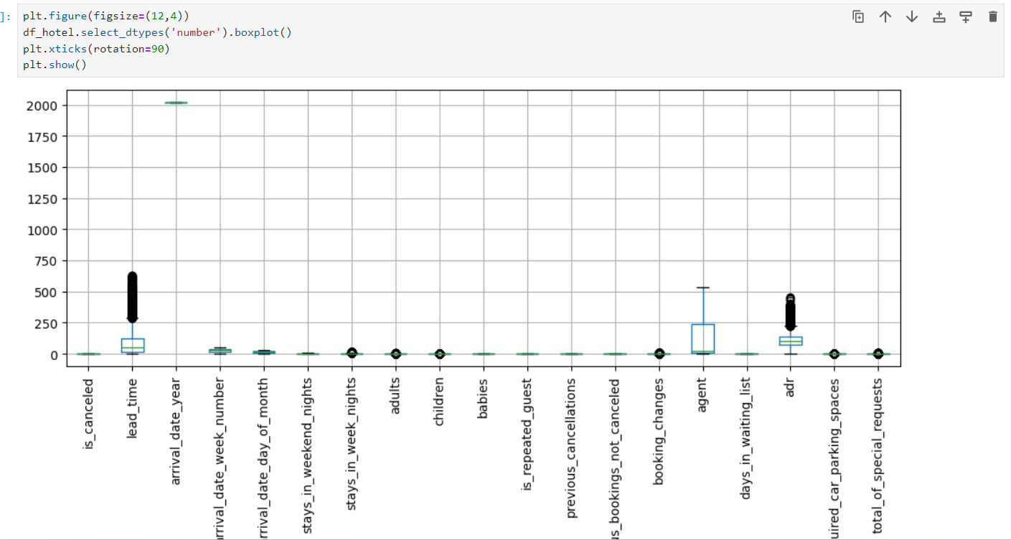
The boxplot visualizes the distribution of numerical features in the hotel dataset, highlighting potential outliers and central tendencies. Varied box lengths and whisker ranges indicate differing data spreads.
This aids in identifying data variability and potential trends, supporting comprehensive exploratory data analysis.

Slide 16
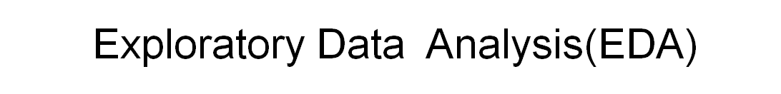
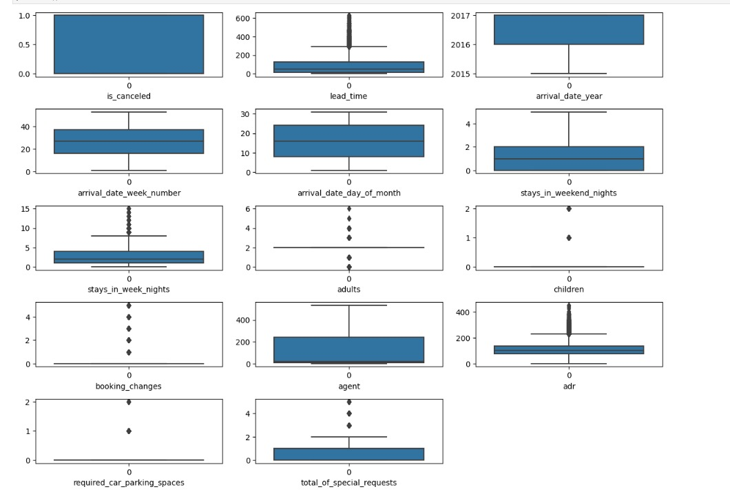
Univariate Analysis : We perform Univariate Analysis on Numerical Variable and Categorical Variable. for this Here, we plotted boxplots for all numerical variables from Seaborn library.

Slide 17
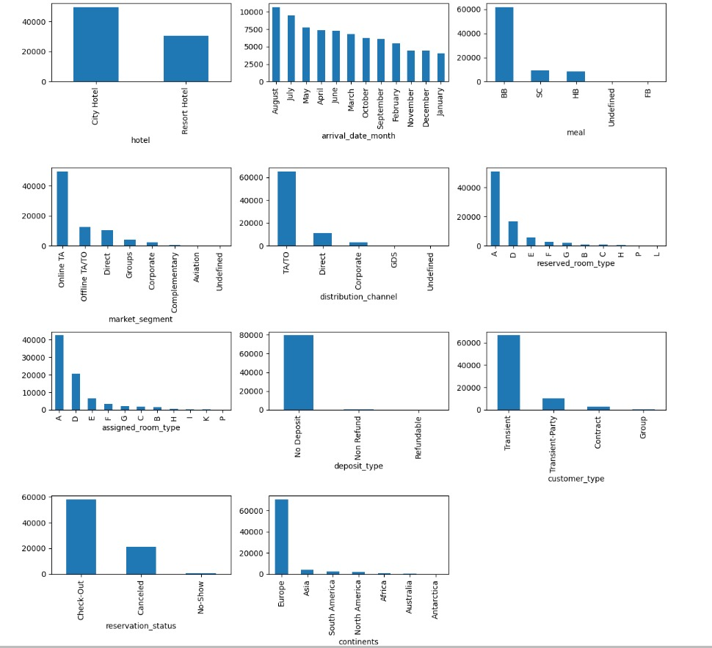
We can infer that City Hotel count is above 60000.
Online Travel Agencies is the most preferred.
Travel Agents and Tour Operators are widely utilized distribution channels.
Most of the hotels are in Europe. Transient customer type is more.
In the month of August, more customers came.
The room type 'A' is assigned to more customers.
Bed and Breakfast is taken by majority of the people.

Slide 18
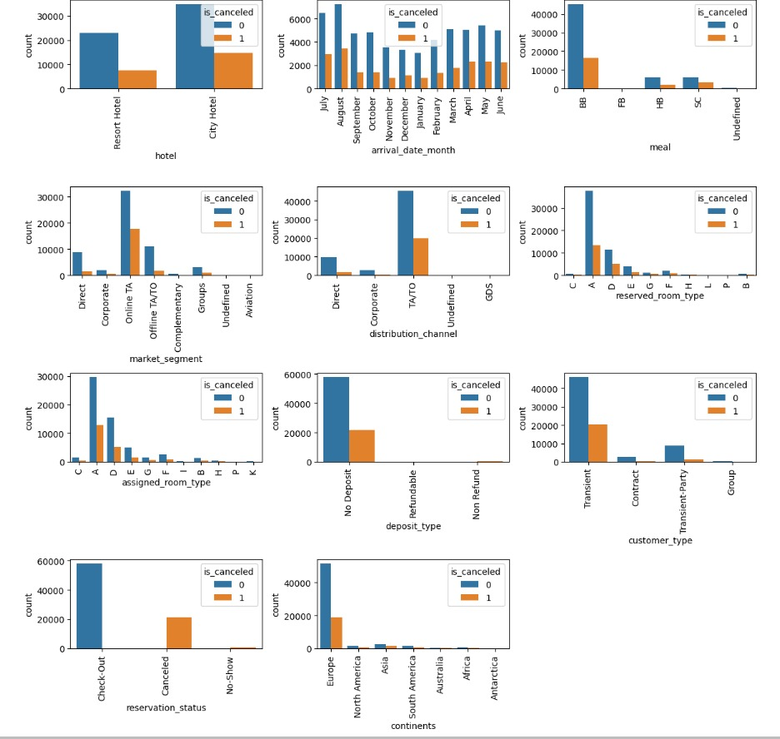
Exploratory Data Analysis(EDA)
Bivariate Analysis:
We perform bivariate analysis to investigate the relationship between target variable and independent variables. Here,we plotted count plot for categorical columns with hue as target column.

Slide 19
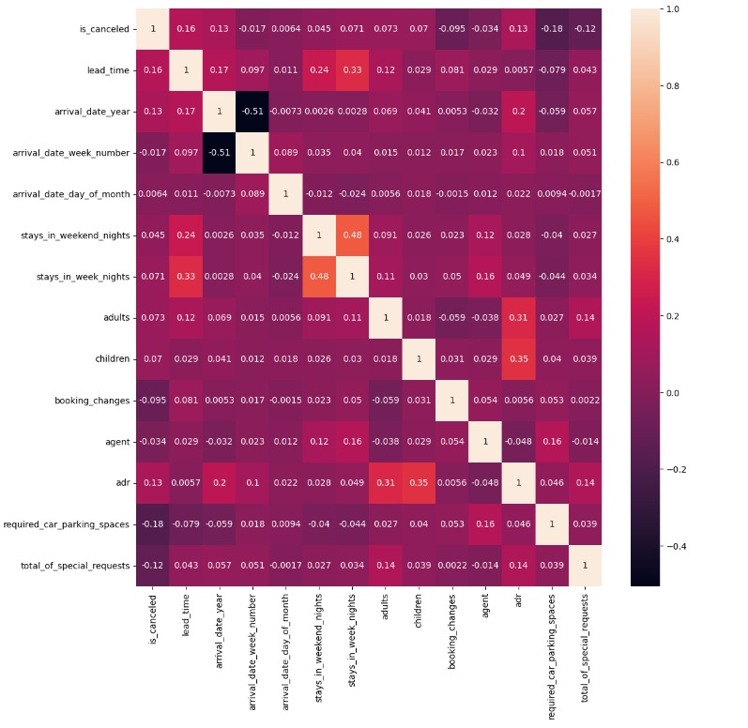
Exploratory Data Analysis(EDA)
Multivariate Analysis: Multivariate Analysis help us to understand how the variables interact with each other, as well as to identify any hidden patterns in the data. Heatmap plot from seaborn library for Multivariate Analysis.

Slide 20
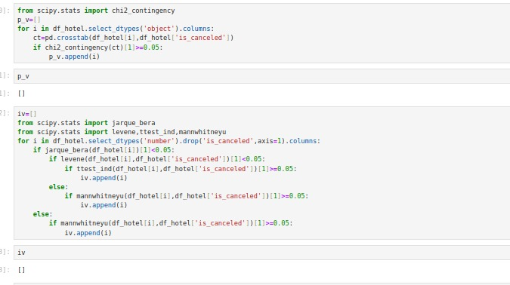
STATISTICAL TESTS
This Python code uses statistical tests to identify categorical and numerical features that are likely not significantly associated with the target variable 'is_canceled' in a hotel dataset. For categorical features, the code employs the chi-squared test, retaining those with p-values greater than or equal to 0.05. Regarding numerical features, the code uses the Jarque-Bera test for normality, Levene's test for homogeneity of variances, and either the independent samples t-test or Mann-Whitney U test based on the normality assumption. Numerical features with p-values above 0.05 are selected, indicating potential candidates for exclusion in predictive modeling due to their limited association with the 'is_canceled' target variable.

Slide 21
Splitting of Dataset
We have splitted the dataset into training and testing data using train_test_split function with test_size as 30% and random_state as 10.

Slide 22
SCALING & TRANSFORMATION
Scaling and transformation are two common data preprocessing techniques used to prepare data for analysis or modelling. Scaling involves transforming the values of the features in a dataset toa common scale, typically by subtracting the mean and dividing by the standard deviation. This is done to ensure that all features have the same scale and range, which can be important for certain algorithms, such as those that are distance-based. Transformation involves applying a mathematical function to the values of the features in a dataset to transform them in a specific way.
Yeo-Johnson Power Transformation is a data transformation technique used to normalize numerical data that may not follow a normal distribution. It is an extension of the Box-Cox transformation that can handle both positive and negative values. The Yeo-Johnson transformation applies a power transformation to the data using a lambda parameter that is chosen to maximize the normality of the transformed data.

Slide 23
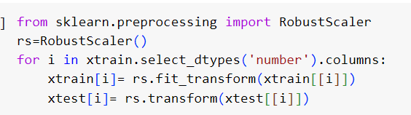
We have done robust scaler here.
CHECKING FOR CLASS IMBALANCE
In this case, the '0' class represents about 63% of the samples, while the '1' class represents only 37% of the samples. There is no class imbalance present here.

Slide 24
MODEL BUILDING
Step by step approach for model building: -
1) Data Preprocessing: Clean and preprocess the data by handling missing values, encoding categorical features, scaling numerical features, and removing outliers.
2) Data Splitting: Split the data into training, validation, and testing sets. The training set is used to train the model, the validation set is used to tune the hyperparameters of the model, and the testing set is used to evaluate the final performance of the model.
3) Feature Engineering: Create new features from existing ones that can improve the model's predictive power. This can involve transforming or combining features, extracting new features from text or images, or engineering domain-specific features.
4) Model Selection: Select an appropriate machine learning model for the problem at hand, based on the type of data, the size of the dataset, and the performance metrics. Consider using simple models first, and gradually increasing complexity if necessary.

Slide 25
5) Hyperparameter Tuning: Tune the hyperparameters of the chosen model to optimize its performance on the validation set. This can involve selecting the best learning rate, regularization parameter, activation function, number of hidden layers, and other parameters.
6) Model Training: Train the final model on the entire training set using the optimized hyperparameters.
7) Model Evaluation: Evaluate the final model on the testing set using appropriate performance metrics such as accuracy, precision, recall, F1-score, or AUC-ROC curve. Compare the performance of the model with the baseline and previous state-of-the-art methods.
8) Model Deployment: Deploy the final model in a production environment, such as a web application, mobile app, or API, and monitor its performance over time. Update the model as necessary to improve its accuracy or adapt to changing data distributions.
Overall, this step-by-step approach provides a structured and systematic way to build, evaluate, and deploy machine learning models, and can help ensure the quality and robustness of the models.

Slide 26
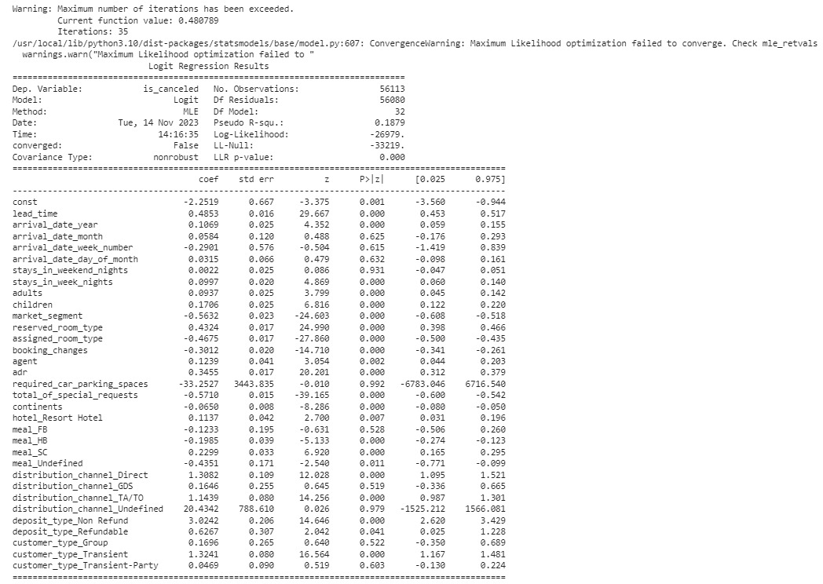
BASE MODEL (Logistic Regression Model)
LOGISTIC REGRESSION SUMMARY:

Slide 27
Based on the p-values, several of the predictor variables appear to be significantly associated with the probability of an items, including lead_time, arrival_date_year, stays_in_week_nights, adults, children, market_segment, reserved_room_type, assigned_room_type, booking_changes, agent, adr, total_of_special_requests, continents, hotel_Resort Hotel, meal_HB, meal_SC, meal_Undefined, distribution_channel_Direct, distribution_channel_TA/TO, deposit_type_Non Refund, deposit_type_Refundable, customer_type_Transient.
The coefficients for arrival_date_month, arrival_date_week_number, arrival_date_day_of_month, stays_in_weekend_nights, required_car_parking_spaces, meal_FB, distribution_channel_GDS, distribution_channel_Undefined, customer_type_Group, customer_type_Transient-Party do not appear to be significant as their p-values are greater than 0.05. However, it's important to note that the model failed to converge and further analysis may be needed to determine the robustness of the results.

Slide 28
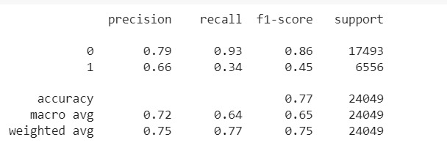
TEST REPORT FOR BASE MODEL:
Class 0 (Negative Instances):
Precision (0.79): 79% of instances predicted as 0 were actually negative.
Recall (0.93): The model correctly identified 93% of all actual negative instances.
F1-score (0.86): The harmonic mean of precision and recall for negative instances is 86%.
Support (17493): There are 17493 instances of negative class in the dataset.
Class 1 (Positive Instances):
Precision (0.66): 66% of instances predicted as 1 were actually positive.
Recall (0.34): The model correctly identified 34% of all actual positive instances.
F1-score (0.45): The harmonic mean of precision and recall for positive instances is 45%.
Support (6556): There are 6556 instances of positive class in the dataset.
Fig: Test Report (Base Model)

Slide 29
Overall Model Performance:
Accuracy (0.77): The accuracy of the model is 77%, meaning 77% of instances were correctly predicted.
Weighted Average:
Precision (0.75): The weighted precision, accounting for class imbalance, is 75%.
Recall (0.77): The weighted recall, accounting for class imbalance, is 77%.
F1-score (0.75): The weighted F1-score, accounting for class imbalance, is 75%.
Analysis:
The model performs well in accurately predicting negative instances (Class 0) with high precision and recall. However, there is room for improvement in predicting positive instances (Class 1), as reflected in lower precision and recall. The overall accuracy is 77%, and attention should be given to enhancing the model's ability to correctly identify positive instances.

Slide 30
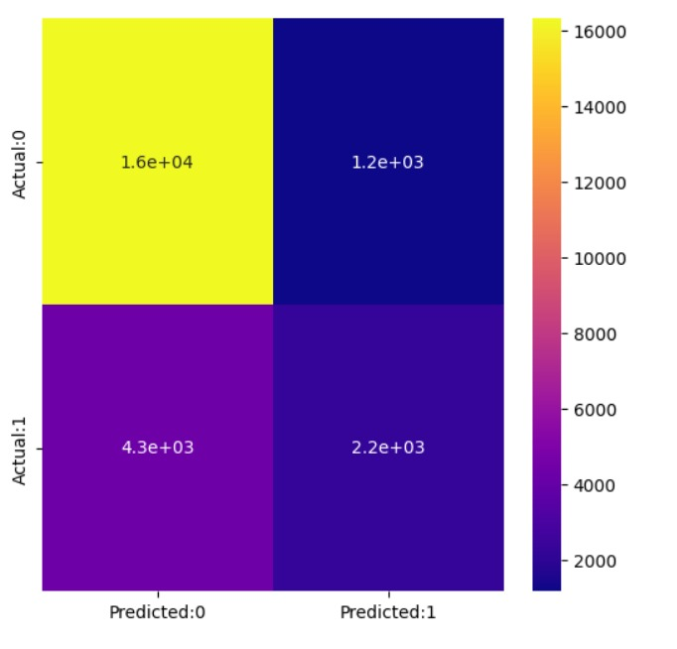
CONFUSION MATRIX
The confusion matrix is used to calculate various performance metrics for logistic regression model, such as accuracy, precision, recall, and F1 score.
In our case logistic regression model produced the following results:
True Positives (TP): 2244 instances were correctly predicted as positive.
True Negatives (TN): 16317 instances were correctly predicted as negative.
False Positives (FP): 1176 instances were predicted as positive but were actually negative.
False Negatives (FN): 4312 instances were predicted as negative but were actually positive.
This indicates that the model has relatively high accuracy in predicting negative instances (Class 0) but struggles with false negatives in predicting positive instances (Class 1).
Fig: Confusion Matrix

Slide 31

PERFORMANCE METRICS:
Fig: Performance Metrics(Base Model)
The model's accuracy is 0.771, which indicates that the model correctly classified 77.1% of the instances in the dataset.
The precision of the model is 0.654, which means that out of all instances predicted as positive, 65.4% were actually positive.
Call of the model is 0.342, which means that out of all actual positive instances, the model correctly identified 34.2%.
The F1-score of the model is 0.449, which is the harmonic mean of precision and recall, and provides a balance between these two metrics.
The kappa value of 0.323 suggests that there is less agreement between the predictions made by the model and the actual values. This metric is useful in assessing inter-rater agreement, and values close to 1 indicate strong agreement, while values close to 0 indicate chance agreement.
AUC-ROC is a metric that measures the area under the receiver operating characteristic (ROC) curve. The ROC curve is a plot of true positive rate (recall) versus false positive rate (1 - specificity) at various thresholds. In our case, the AUC-ROC is 0.788, indicating that the model performs moderately well at distinguishing between positive and negative instances.
Overall, the model appears to have moderate performance in terms of accuracy, precision, recall, F1-score, kappa value. There may be room for improvement in the model's performance, especially in identifying positive instances.

Slide 32
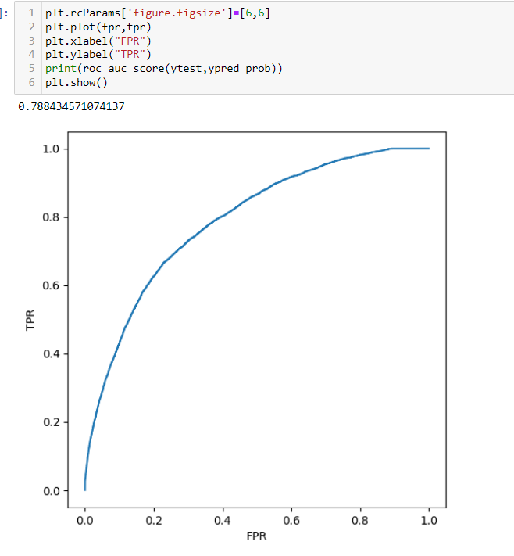
ROC CURVE
The AUC of logistic regression model on the test data is approximately 0.788. AUC-ROC is a metric that measures the area under the receiver operating characteristic (ROC) curve. The ROC curve is a plot of true positive rate (recall) versus false positive rate (1 -specificity) at various thresholds. In this case, the AUC-ROC is 0.78843 ,indicating that the model performs moderately well at distinguishing between positive and negative instances.
Fig: ROC CURVE

Slide 33
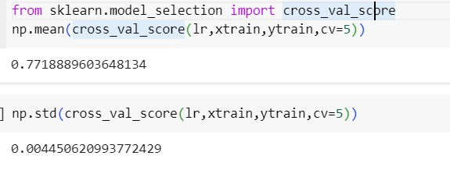
Cross-Validation
The cross-validation results for a logistic regression model indicate an average accuracy of approximately 77.2% with a standard deviation of approximately 0.0045. This suggests that the model performs consistently across different folds, and the low standard deviation implies stability in the model's performance.
The average accuracy of 77.2% indicates that, on average, the model correctly predicts the target variable for 77.2% of the instances in the training data across the five folds. This provides a reasonable level of predictive performance.
Fig: Cross-Validation
The small standard deviation of 0.0045 suggests that the model's performance is robust and not highly sensitive to the specific subset of data used in each fold. A low standard deviation is desirable as it indicates less variability in the model's performance, contributing to its reliability.
In summary, the logistic regression model exhibits consistent and stable performance with an average accuracy of 77.2% across five-fold cross-validation. Further model evaluation and tuning can be performed to optimize its predictive capabilities.

Slide 34
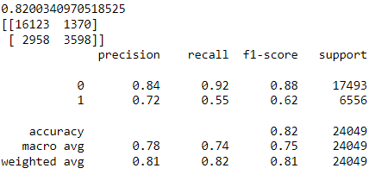
Random Forest Classifier:
Fig: Test Report (Random Forest Classifier)
The RFC model appears to be a very effective approach for predicting the target variable. The model has performed very well on both the training and test sets.
The Random Forest classifier demonstrates strong predictive performance on the test set with an accuracy of 82%.

Slide 35
The confusion matrix provides detailed insights into the model's classifications:
True Negatives (16123): Instances correctly predicted as negative.
False Positives (1370): Instances predicted as positive but are actually negative.
False Negatives (2958): Instances predicted as negative but are actually positive.
True Positives (3598): Instances correctly predicted as positive.
The precision-recall trade-off is evident in the classification report. Class 0 exhibits high precision (84%) and recall (92%), indicating effective identification of negative instances. However, Class 1 has lower precision (72%) and recall (55%), highlighting challenges in predicting positive instances.
The weighted average F1-score is 81%, emphasizing a balanced performance considering class imbalance. The model's macro-average F1-score is 75%, indicating a consistent measure across both classes.
In conclusion, the Random Forest model performs well overall, particularly in predicting negative instances. However, there's room for improvement in predicting positive instances, and further optimization or exploration of different algorithms may enhance the model's overall effectiveness.

Slide 36

PERFORMANCE METRICS:
Fig: Performance Metrics (Random Forest)
The Random Forest model achieves an accuracy of 82%, implying that it correctly predicts the target variable for 82% of instances in the dataset. While this indicates good overall predictive performance, a more detailed examination reveals nuances in the model's ability to handle positive instances (Class 1).
The recall for Class 1 is 54.88%, signifying that the model successfully captures 54.88% of actual positive instances. This metric is crucial in scenarios where correctly identifying positive instances is of high importance, such as identifying potential risks or rare events.
Precision for Class 1 is 72.42%, indicating that 72.42% of instances predicted as positive are indeed positive. Precision is valuable when the cost of false positives is high, as it represents the model's ability to make accurate positive predictions.
The F1 score, a harmonic mean of precision and recall, is 62.44%. This provides a balanced measure, considering both false positives and false negatives. It emphasizes the need for a model that can effectively balance precision and recall, especially in scenarios with imbalanced classes.
Kappa statistic of 0.509 indicates moderate agreement beyond chance. While not too high, it suggests that model's performance is better than random chance.
In conclusion, while Random Forest model indicates strong overall accuracy, there is room to improve in its ability to accurately identify positive instances. Further optimization of alternative models may enhance the model's performance, specially where the correct identification of positive cases is critical.

Slide 37
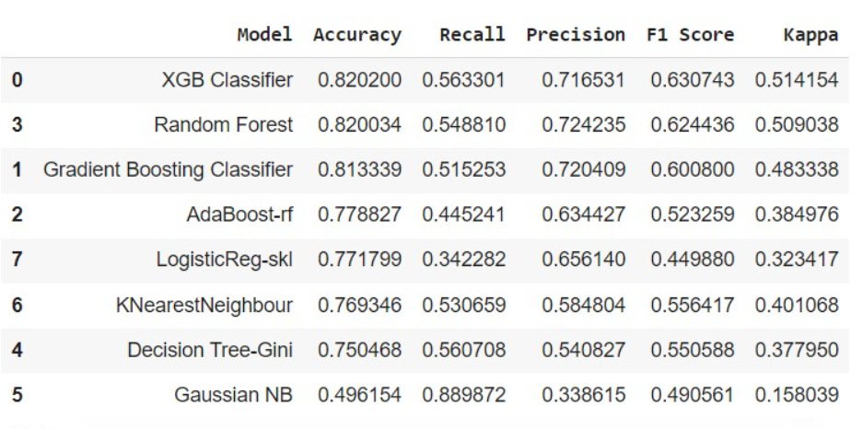
Comparison of Performance of Different Models:
Based on the evaluation metrics, the XG Boost model has the highest accuracy (0.82), recall (0.563), precision (0.716), F1 score (0.630), kappa score (0.514) among all the models evaluated. This indicates that the XG Boost model is the best-performing model for the given task.

Slide 38
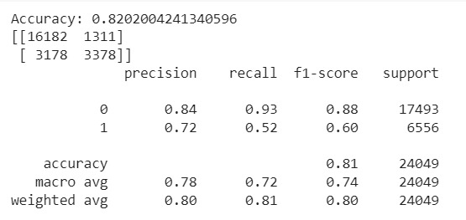
XGBOOST CLASSIFIER:
The XG Boosting Classifier achieves an accuracy of 82.08% on the test set. The confusion matrix provides a detailed breakdown of the model's predictions:
True Negatives (16182): Instances correctly predicted as negative.
False Positives (1311): Instances predicted as positive but are actually negative.
False Negatives (3178): Instances predicted as negative but are actually positive.
True Positives (3378): Instances correctly predicted as positive.
Precision for Class 0 (negative instances) is high at 84%, indicating a good ability to correctly identify negative cases. However, precision for Class 1 (positive instances) is 72%, and recall is 52%, suggesting challenges in accurately predicting positive instances. The model demonstrates an overall F1-score of 60%.
Fig: Test Report (XGBoost Classifier)
The weighted average F1-score is 80%, considering class imbalance, and the macro-average F1-score is 74%, indicating a balanced measure across both classes. The model's accuracy is comparable to the Random Forest model but exhibits a trade-off between precision and recall for positive instances. Further optimization or tuning may enhance its performance, especially in scenarios where correctly identifying positive instances is crucial.

Slide 39
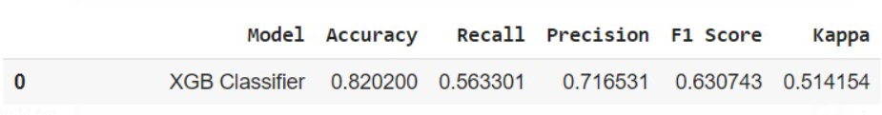
PERFORMANCE METRICS:
Fig: Performance Metrics(XG Boosting Classifier)
The XGBoosting Classifier achieves an accuracy of 82%, indicating its ability to correctly predict the target variable for a significant portion of instances in the dataset. However, a more nuanced understanding of its performance is revealed through additional metrics:
Recall (Sensitivity): The model exhibits a recall of 56.3% for positive instances (Class 1), implying that it successfully identifies 56.3% of all actual positive instances. A higher recall is desirable in scenarios where the cost of missing positive instances is high.
Precision: The precision for Class 1 is 71.6%, indicating that 71.6% of instances predicted as positive are indeed positive. Precision is crucial in scenarios where the cost of false positives is significant.
F1 Score: The F1 score, which considers both precision and recall, is 63%. This metric provides a balanced measure of the model's overall performance.
Kappa Statistic: The Kappa statistic of 51.4% suggests moderate agreement beyond chance. This metric accounts for the possibility of correct predictions occurring by random chance.
In summary, the XGB demonstrates solid overall accuracy, but there is room for improvement in correctly identifying positive instances. Further optimization or tuning may enhance its precision and recall balance, especially in scenarios where correctly identifying positive cases is crucial.

Slide 40
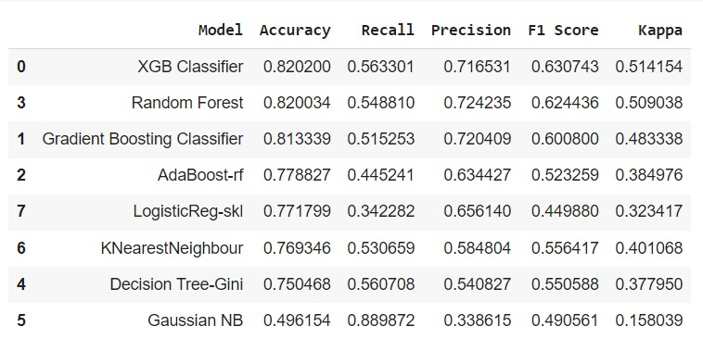
Comparison of Performance of Different Models:
Fig: Overall Comparison of Performance of all Models
1) XGB Classifier:
Achieves the highest accuracy of 82.02%, demonstrating robust predictive performance.
High recall (56.33%) for positive instances, indicating effective identification of actual positives.
Good precision (71.65%) and balanced F1 score (63.07%) reflect strong overall model performance.
Kappa statistic of 51.42% indicates substantial agreement beyond chance.

Slide 41
2) Random Forest:
Like XGB, with an accuracy of 82.00%, precision, recall, and F1 score also comparable.
Achieves a balanced trade-off between precision and recall for positive instances.
Kappa statistic of 50.90% suggests substantial agreement beyond chance
3) Gradient Boosting Classifier:
Slightly lower accuracy at 81.33%, with balanced precision and recall.
Demonstrates good precision (72.04%) but has a lower recall (51.53%) for positive instances.
F1 score of 60.08% indicates a balanced measure of precision and recall.
Kappa statistic of 48.33% suggests moderate agreement beyond chance.
4) AdaBoost-rf:
Lower accuracy at 77.88%, with moderate recall (44.52%) for positive instances.
Precision of 63.44% and F1 score of 52.33% indicate a trade-off between precision and recall.
Kappa statistic of 38.50% suggests moderate agreement beyond chance.
5) LogisticReg-skl:
Accuracy at 77.18%, with low recall (34.23%) for positive instances.
Precision of 65.61% and F1 score of 44.99% indicate challenges in predicting positive instances.
Kappa statistic of 32.34% suggests fair agreement beyond chance.

Slide 42
6) KNearestNeighbour:
Accuracy at 76.93%, with a balanced trade-off between precision (58.48%) and recall (53.07%).
F1 score of 55.64% indicates a balanced measure of precision and recall.
Kappa statistic of 40.11% suggests moderate agreement beyond chance.
7) Decision Tree-Gini:
Achieves 75.05% accuracy, with a good recall (56.07%) for positive instances.
Precision of 54.08% and F1 score of 55.06% indicate a balanced measure of precision and recall.
Kappa statistic of 37.80% suggests moderate agreement beyond chance.
8) Gaussian NB:
Lowest accuracy at 49.62%, with high recall (88.99%) but low precision (33.86%) for positive instances.
F1 score of 49.06% indicates an imbalance between precision and recall.
Kappa statistic of 15.80% suggests poor agreement beyond chance.
Overall:
XGB Classifier and Random Forest stand out with the highest accuracy and balanced precision-recall trade-off.
Models vary in their performance, emphasizing the importance of choosing the right model for specific goals and datasets.
Precision and recall metrics offer insights into the models' ability to handle positive instances, crucial in various real-world applications.

Slide 43


HYPERPARAMETER TUNING
XGBOOST Using GridSearchCV:
Fig:XGBoost using GridSearch CV
After hyperparameter tuning, the XGB Classifier demonstrates notable improvements in its performance:
Accuracy: The model achieves an accuracy of 82.31%, showcasing enhanced predictive capability compared to the untuned version.
Recall: The recall for positive instances (Class 1) increases to 57.06%, indicating improved sensitivity in identifying actual positive cases.
Precision: Precision for Class 1 improves to 72.21%, suggesting a better ability to make accurate positive predictions.
F1 Score: The F1 score reaches 63.58%, reflecting a more balanced measure of precision and recall. This improvement indicates a strengthened overall performance.
Kappa Statistic: The Kappa statistic increases to 52.57%, signifying substantial agreement beyond chance. This suggests that the tuned XGB Classifier performs significantly better than random chance.
In summary, the hyperparameter tuning process enhances the XGB Classifier's accuracy, recall, precision, and overall F1 score. These improvements emphasize the effectiveness of selecting optimal hyperparameters to fine-tune the model for better performance on the given dataset.

Slide 44
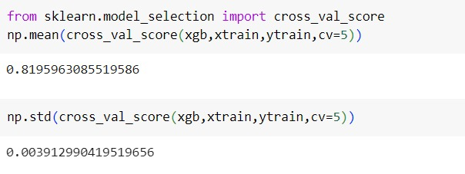
2. Cross-Validation
The cross-validation results for Extreme Gradient Boosting Classifier model indicate an average accuracy of approximately 81.9% with a standard deviation of approximately 0.0039. This suggests that the model performs consistently across different folds, and the low standard deviation implies stability in the model's performance.
The average accuracy of 81.9% indicates that, on average, the model correctly predicts the target variable for 81.9% of the instances in the training data across the five folds. This provides a reasonable level of predictive performance.
Fig (Cross- Validation)
The small standard deviation of 0.0039 suggests that the model's performance is robust and not highly sensitive to the specific subset of data used in each fold. A low standard deviation is desirable as it indicates less variability in the model's performance, contributing to its reliability.
In summary, the logistic regression model exhibits consistent and stable performance with an good accuracy of 81.% across five-fold cross-validation. Further model evaluation and tuning can be performed to optimize its predictive capabilities.

Slide 45
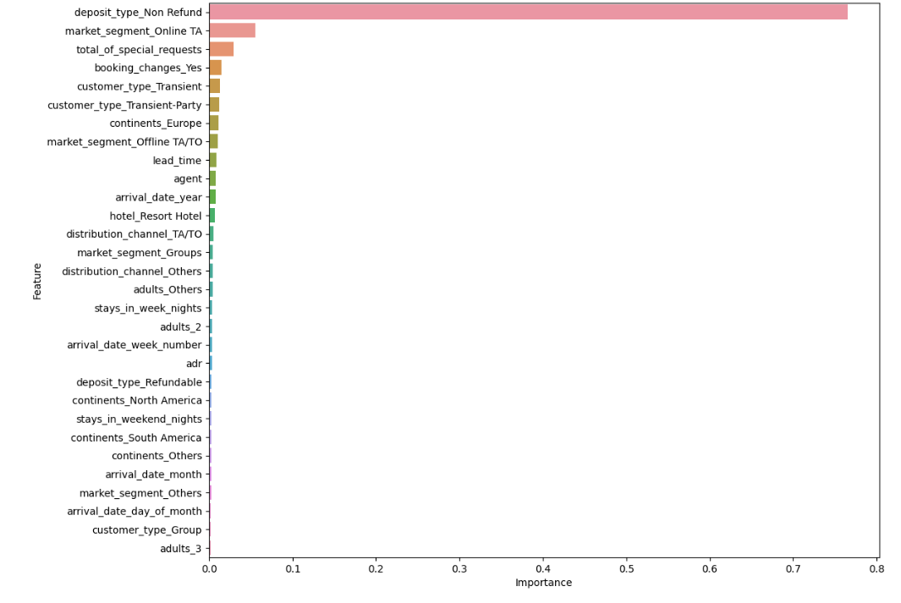
Feature Importance
The most important feature for the model is "deposit_type_non_refund", which has an importance score of 0.78. The next most important features are "market_segment_online_TA" and "total_of_special_requests" with importance scores of 0.11 and 0.07, respectively
It's important to note that feature importance scores can vary depending on the specific model anddataset used. Therefore, it's always good practice to evaluate the feature importance of a model to better understand which features are driving its predictions.
Fig: FeatureImportance

Slide 46
CONCLUSION
By accurately predicting which bookings are likely to be canceled, hotels can optimize their room allocation, adjust pricing strategies, and minimize the impact of cancellations on revenue. This approach allows hotels to strike a balance between short-term gains and long-term stability, overcoming the challenges posed by initiatives like Booking Genius.
Random Forest and XGBoost exhibit relatively better overall performance compared to other models in terms of accuracy, AUC, recall, precision, and F1-score. These models are promising candidates for further consideration. After fine tuning the hyperparameters in XGBoost, we got the best model as XGBoost Classifier. We got the deposit_type_non_refund feature as the important feature to consider. So we need to focus more on it.
Our hotel booking cancellation prediction project has successfully developed a predictive model with commendable performance metrics, including accuracy, precision, and recall. The identified key predictors shed light on significant factors influencing booking cancellations, offering valuable insights for hotel management. These findings can inform strategic decisions related to resource optimization, targeted marketing, and overall guest satisfaction

Slide 47


